Slide 1
AS91903 – USE COMPLEX TECHNIQUES TO DEVELOP A DIGITAL MEDIA OUTCOME
Achievement | Achievement with Merit | Achievement with Excellence
Use complex techniques to develop a digital media outcome. | Use complex techniques to develop an informed digital media outcome. | Use complex techniques to develop a refined digital media outcome.

Slide 2
AS91906 - Use complex programming techniques to develop a computer program
Achievement | Achievement with Merit | Achievement with Excellence
Use complex programming techniques to develop a computer program. | Use complex programming techniques to develop an informed computer program. | Use complex programming techniques to develop a refined computer program.

Slide 3
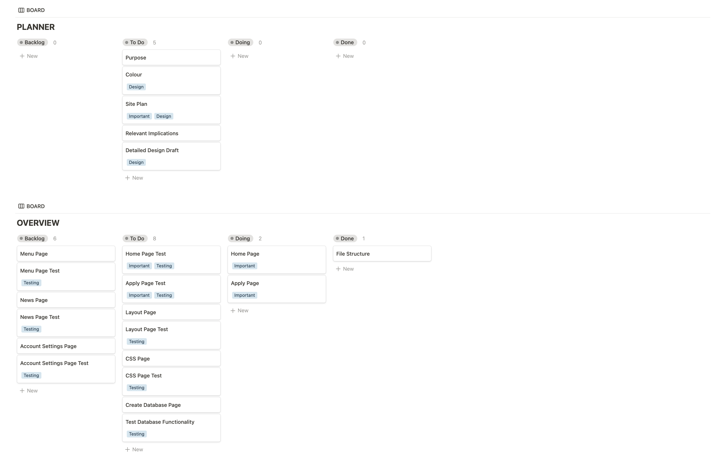
PLANNING

Slide 4
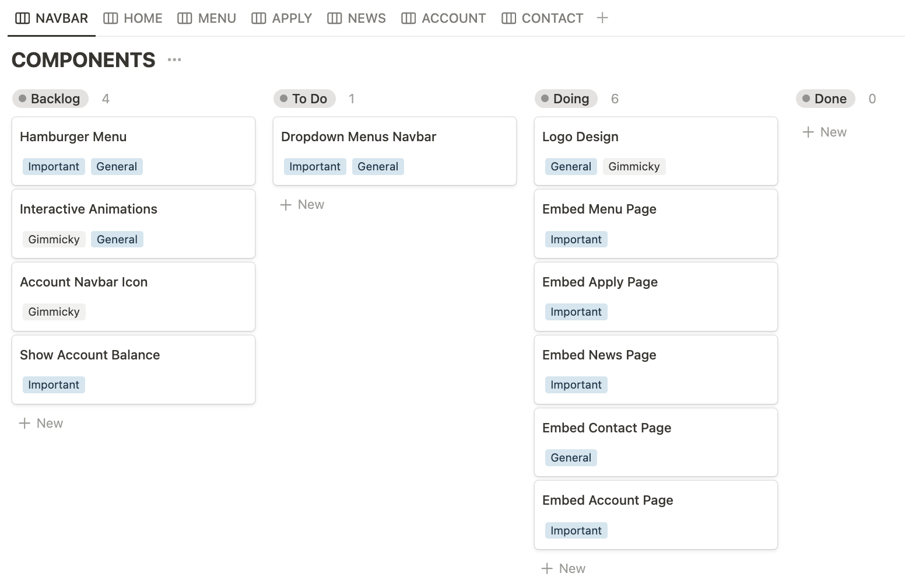
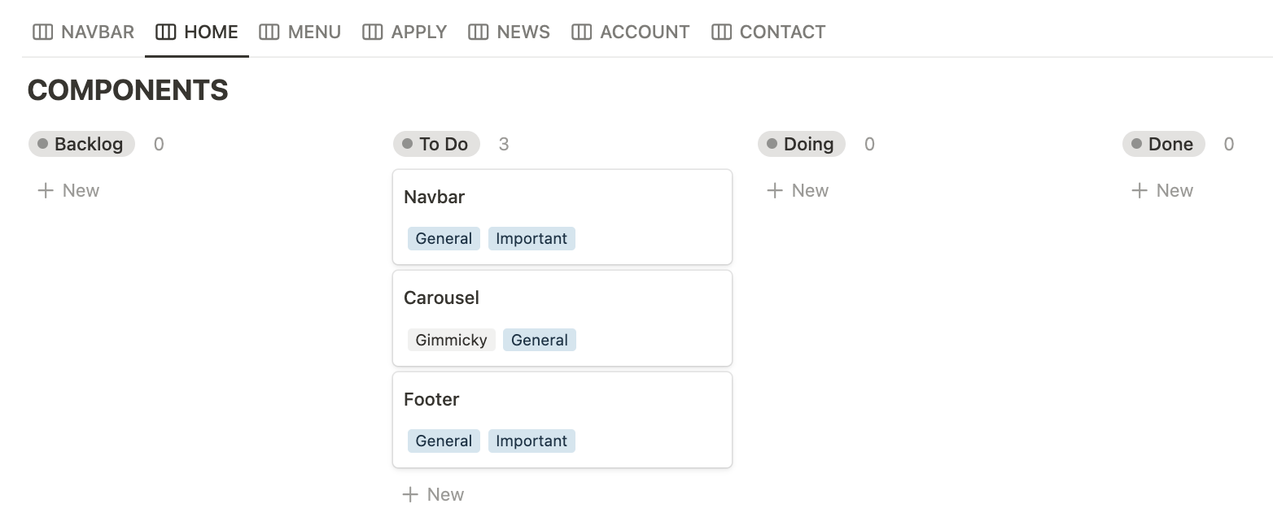
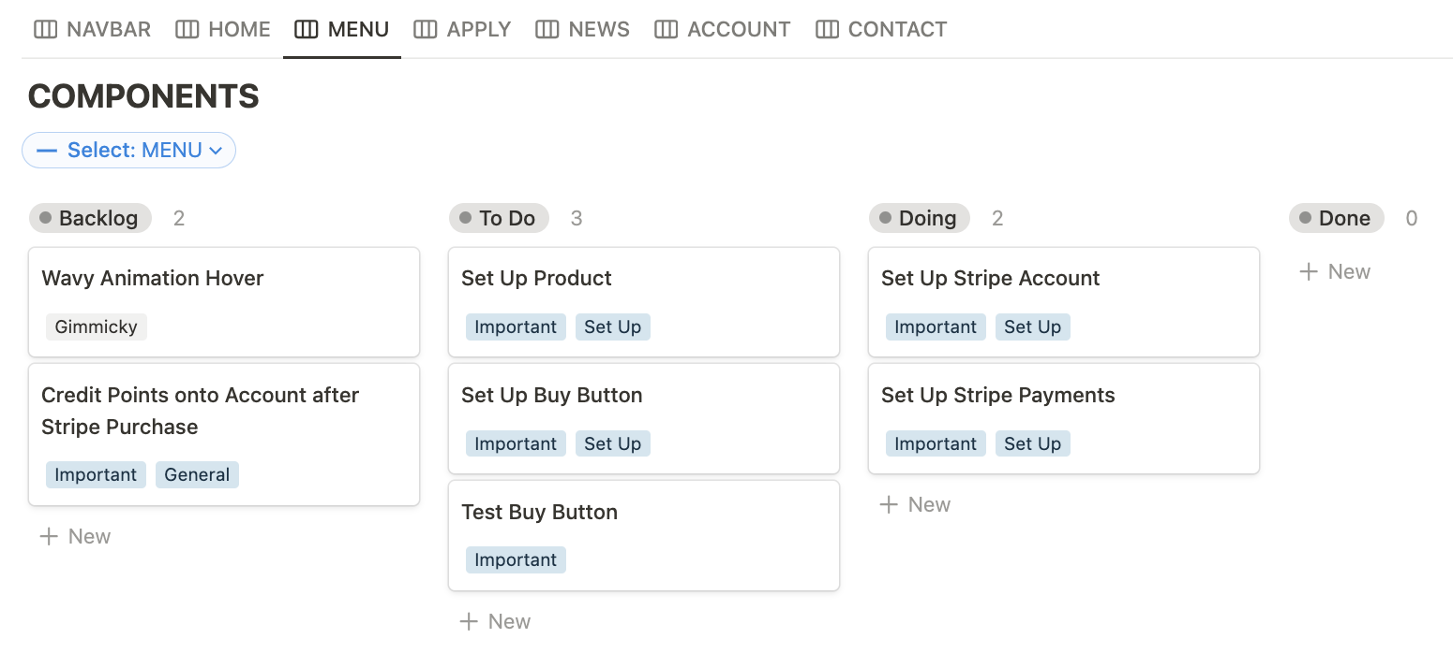
On The Left is a few examples that are on my kanban boards for each sub-component.
Use kanban board to manage my digital outcome in segments. Here I can publish into Git so I can always revert to a safe checkpoint as a failsafe.
Define checkpoints and requirements to progress through my digital outcome
Develop the front page
Testing
Develop the back-end aspect
Testing with dummy cards
Feedback from client and end users
Release to the cafeteria department for use
PLANNING

Slide 5
PURPOSE
Cafeteria website: Ordering stuff on the menu through a points-based system. Users can also apply as a student barista on lunchtime duty.

Slide 6
TARGET AUDIENCE
My digital outcome is only available to Sancta Maria College students and staff. Any user outside of the campus will not be suited for them as Compass Cafe only exists to increase quality of life for fellow students, which is why I plan to make Compass Cafe slightly more interactive than its current state.
All students are welcome to view the menu.
Barista duty applications are exclusive to seniors (year 12-13) to run the cafeteria on those lunchtimes. There could be exceptions of year 11s welcome to be aa partof the lunchtime duties.

Slide 7
INITIAL SPECIFICATIONS
What are the specifications of your project (must haves). You can add to these as you develop your project.
From Client + Stakeholders
Working database with safe payment integration
From Users
Easy user interface – not difficult to operate the admin panel, or sign up for the barista roster

Slide 8
PRIVACY
IMPLICATION 01
The website is only intended for Sancta Maria College's cafeteria as a bridge between students and the school's facilities - payment information is linked, hence funds will be paid to the department. This means that my target audience is only limited to Sancta Maria College and no other users outside of this circle. To protect the students' privacy, their details will not be needed other than school credentials and real name as part of the process for handing out coffees to the right person or signing up as a barista during lunch hours. This means that anything happening within school only occurs in school and data is not compromised, especially from external factors. It could be that I should only be using student IDs as usernames so that people can be identified as is without being known to the general users. As for the payment factor of my website, I will be using Stripe as the payment processing platform and with the help of trusted school cashier to process these payments without compromising banking info and leadmuch financial or personal negative implications.

Slide 9
USABILITY
IMPLICATION 02
It is important to consider usability as an implication for my digital outcome. Having to run the administrative aspect of the cafeteria through my digital outcome means that I will have to design layouts and sitemaps in a way that is engaging and intuitive to my client, and specific stakeholders and users who will be running it. This moreover is not limited to the admins, as users will also need to be guided in the right areas of the website, ensuring things go well so that they do not end up doing something mistakenly, i.e: accidentally buying the wrong drink or unintentionally signing up as a barista. This can be done by implementing features such as an easy-to-follow navigation bar or putting emphasis on interactable elements (also applies to admin panel). It should be addressed as such so that users can easily navigate the sitemap efficiently and without a manual, and admins can easily deal with database entries - all of which must be designed thoughtfully and simply.

Slide 10
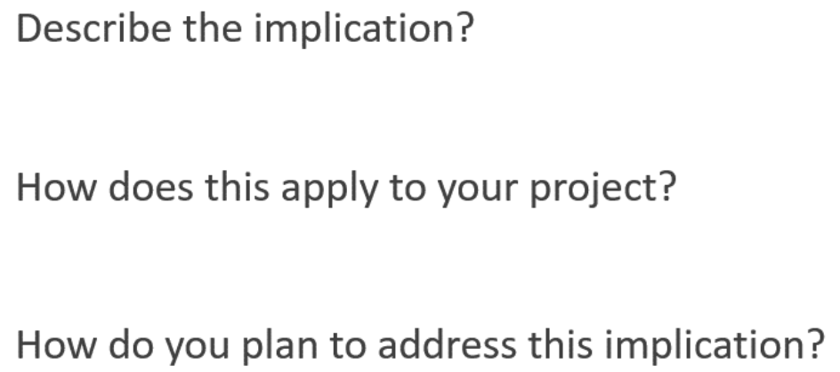
SUSTAINABILITY & FUTURE PROOFING
IMPLICATION 03
Sustainability
Code optimisation
Reusable bottles feature
Possible digital stamp card?
Future Proofing
Code Optimisation (clean, comments, updatable)
Responsive design
Feedback page for iterative improvement onwards
File and data backups to prevent data loss (GitHub)

Slide 11
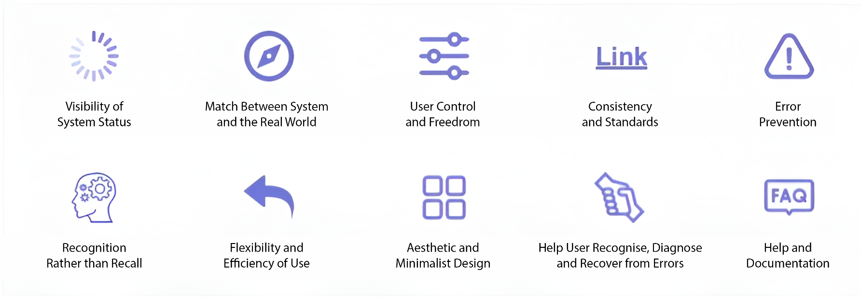
UX PRINCIPLES
Describe the most relevant HCI rules

Slide 12
HCI
Summarise the most relevant usability rules and how they apply to your project (duplicate slide)
- Visibility of System Status
Match Between System & Real World
User control & Freedom
Error Prevention
Flexibility & Efficiency of Use
Aesthetic & Minimalist Design
Error Recovery

Slide 13
RELEVANT CONVENTIONS
These could include:
Coding conventions – HTML, CSS (validated)
Coding conventions – Python (PEP8)
File Naming and file management
Web design conventions
Commenting
Usability Heuristics
Visual Hierarchy

Slide 14
RELEVANT CONVENTIONS
Discuss how you plan to apply relevant conventions to improve the quality of your outcome.

Slide 15


LOGO DESIGN
SANCTA MARIA COLLEGE
COMPASS CAFÉ : CONCEPT

Slide 16
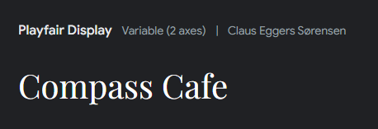
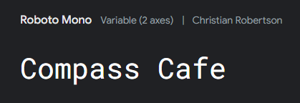
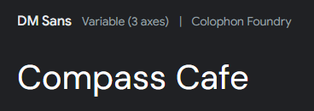
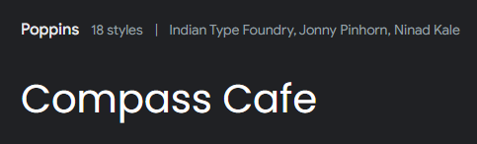
FONTS
WEBSITE DESIGN
GENERAL : CONCEPT
These fonts are easy to read, though my website is heavily on the site with graphic elements. However, It is best to find lettering that can easily help the admin find what they are looking for, such as in the admin dashboard. and bold lettering in navbar.

Slide 17
FONTS
WEBSITE DESIGN
GENERAL : REFINED
Fit for a younger target audience: students at sancta maria college, would most likely be familiar with a modern look for a website than a sophisticated yet formal text (serif). Although serif is aesthetically pleasing and generally easier to read, branding would not suit as well with the cafeteria targeted towards a younger audience.

Slide 18
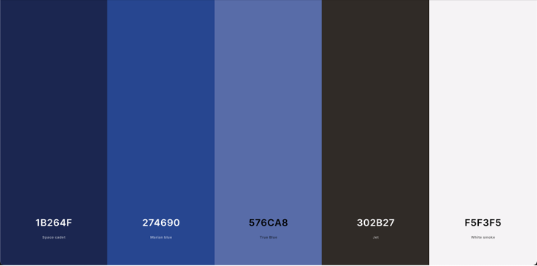
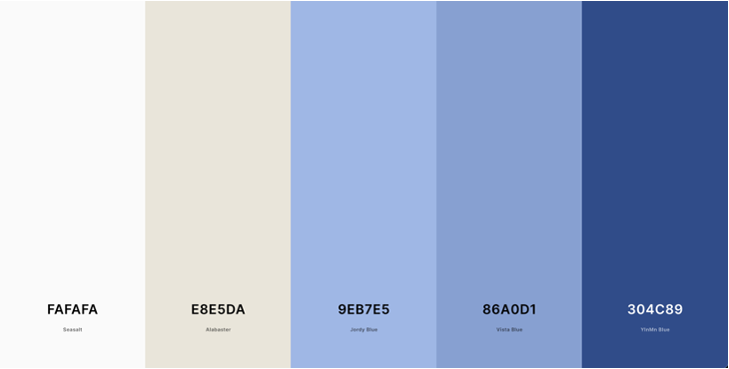
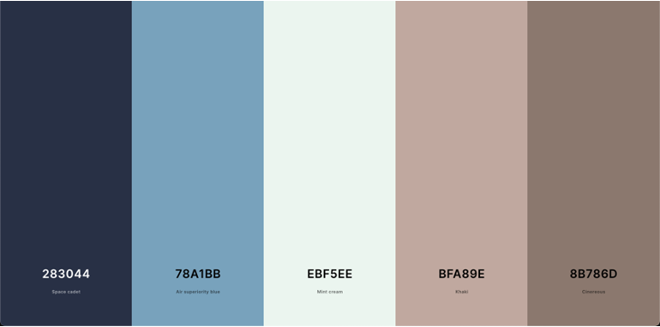
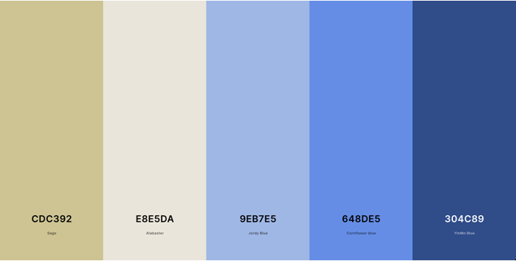
COLOUR PALETTE
WEBSITE DESIGN
GENERAL : CONCEPT

Slide 19
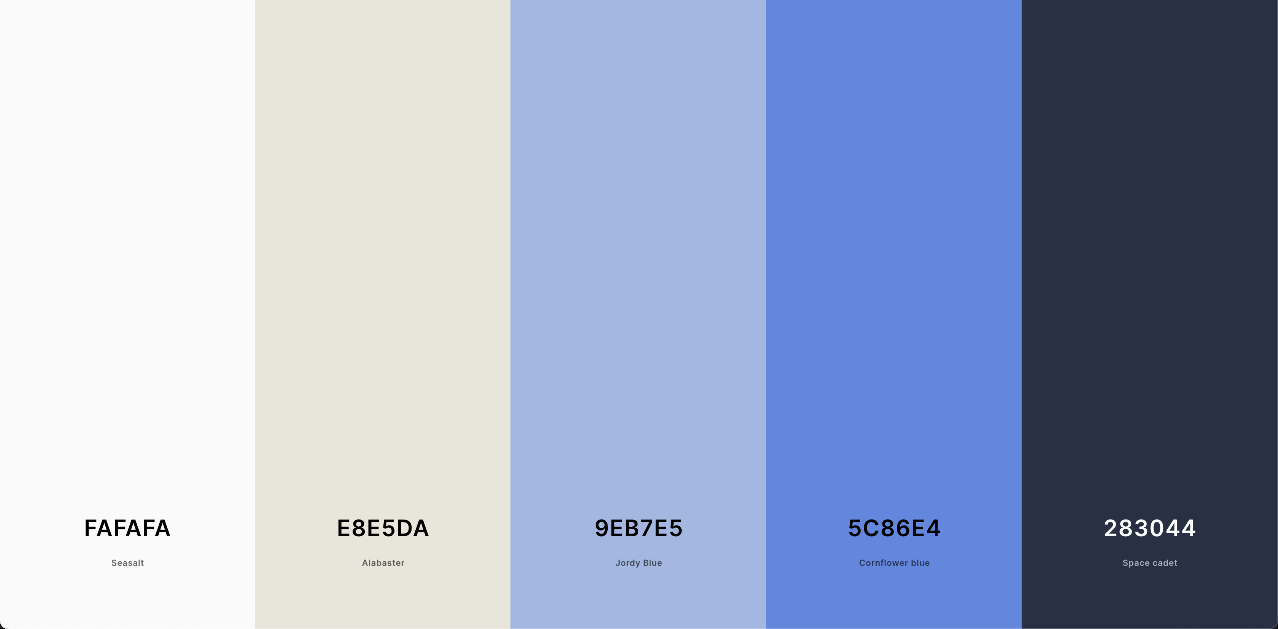
COLOUR PALETTE
WEBSITE DESIGN
GENERAL : REFINED

Slide 20
COLOUR PALETTE
WEBSITE DESIGN
GENERAL : DARK MODE

Slide 21







SITEMAP DESIGN
WEBSITE DESIGN : SITE MAP
BARE-BONES
HOME
NEWS
MENU
APPLY
CONTACT
ACCOUNT
SPECIAL DRINKS
BARISTA LUNCHTIME DUTY
SETTINGS
STAFF DRINKS
SCHEDULES
BALANCE
HOT BEVERAGES
SIGN IN /
REGISTER
COLD BEVERAGES
LOGOUT
[SIGNED IN]

Slide 22
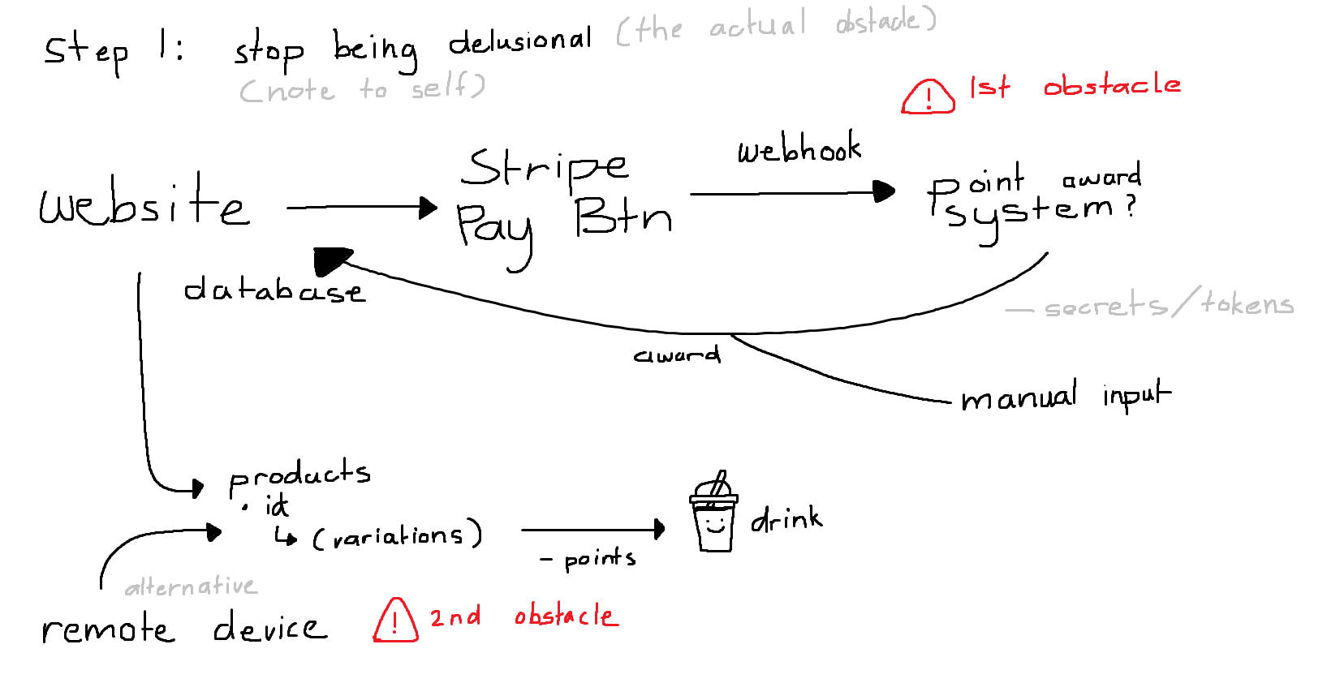
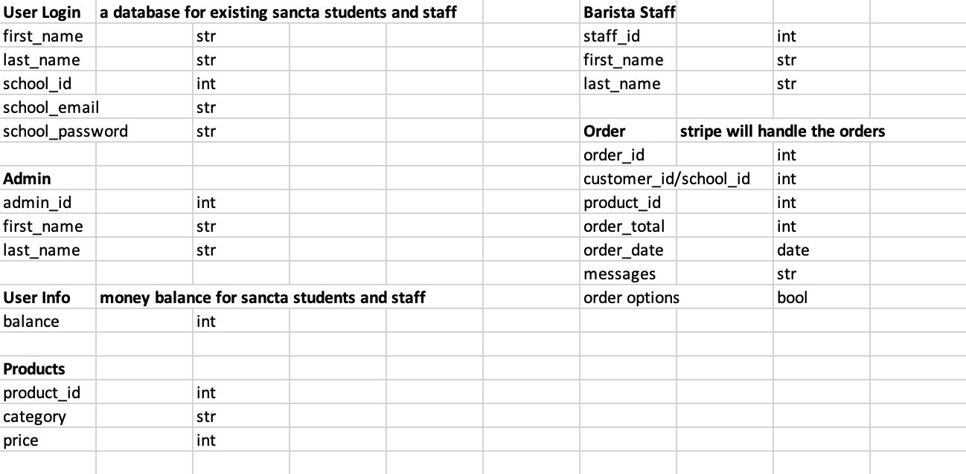



DATABASE DESIGN
WEBSITE DESIGN : DATABASE
BARE-BONES

Slide 23

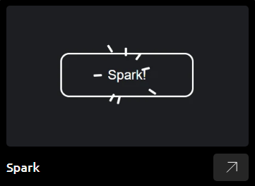
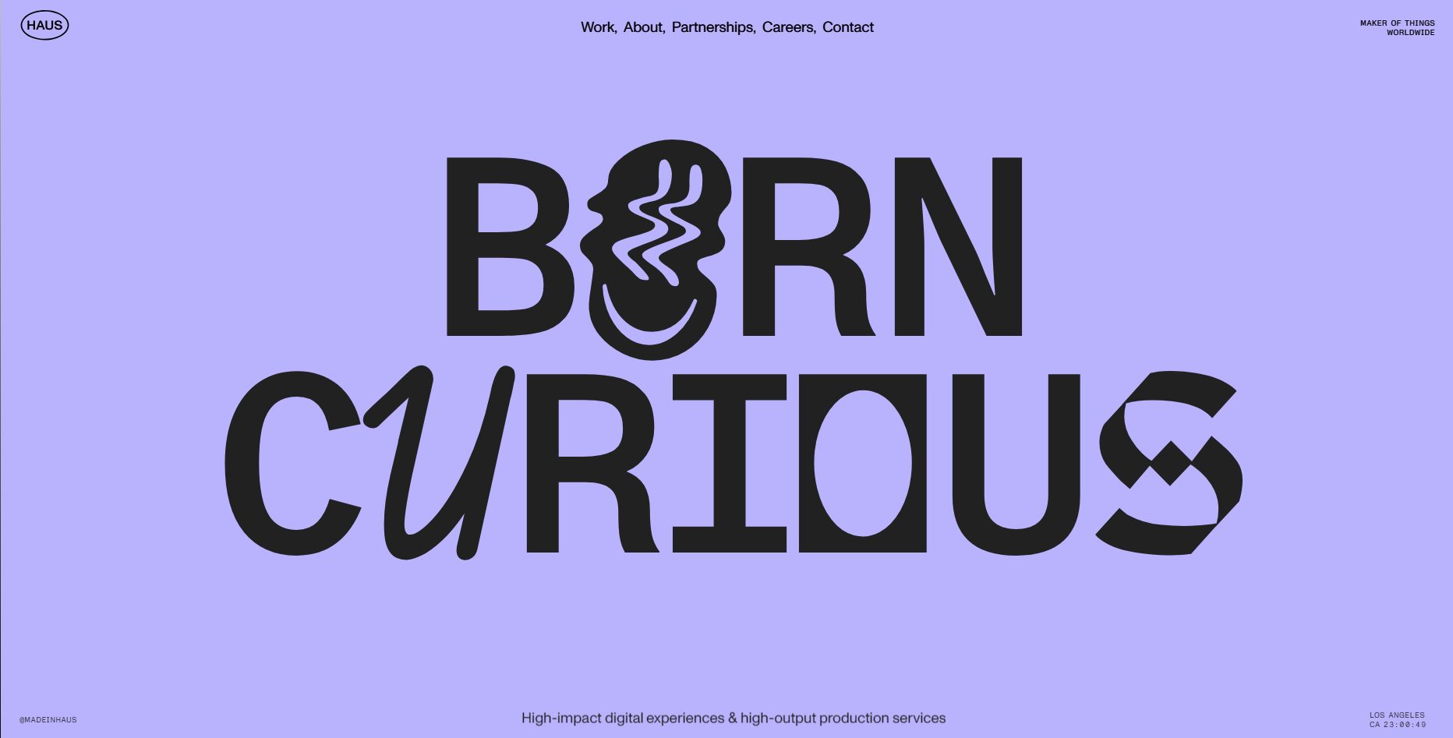
PAGE INSPOS
WEBSITE DESIGN : PAGES
CONCEPT

Slide 24
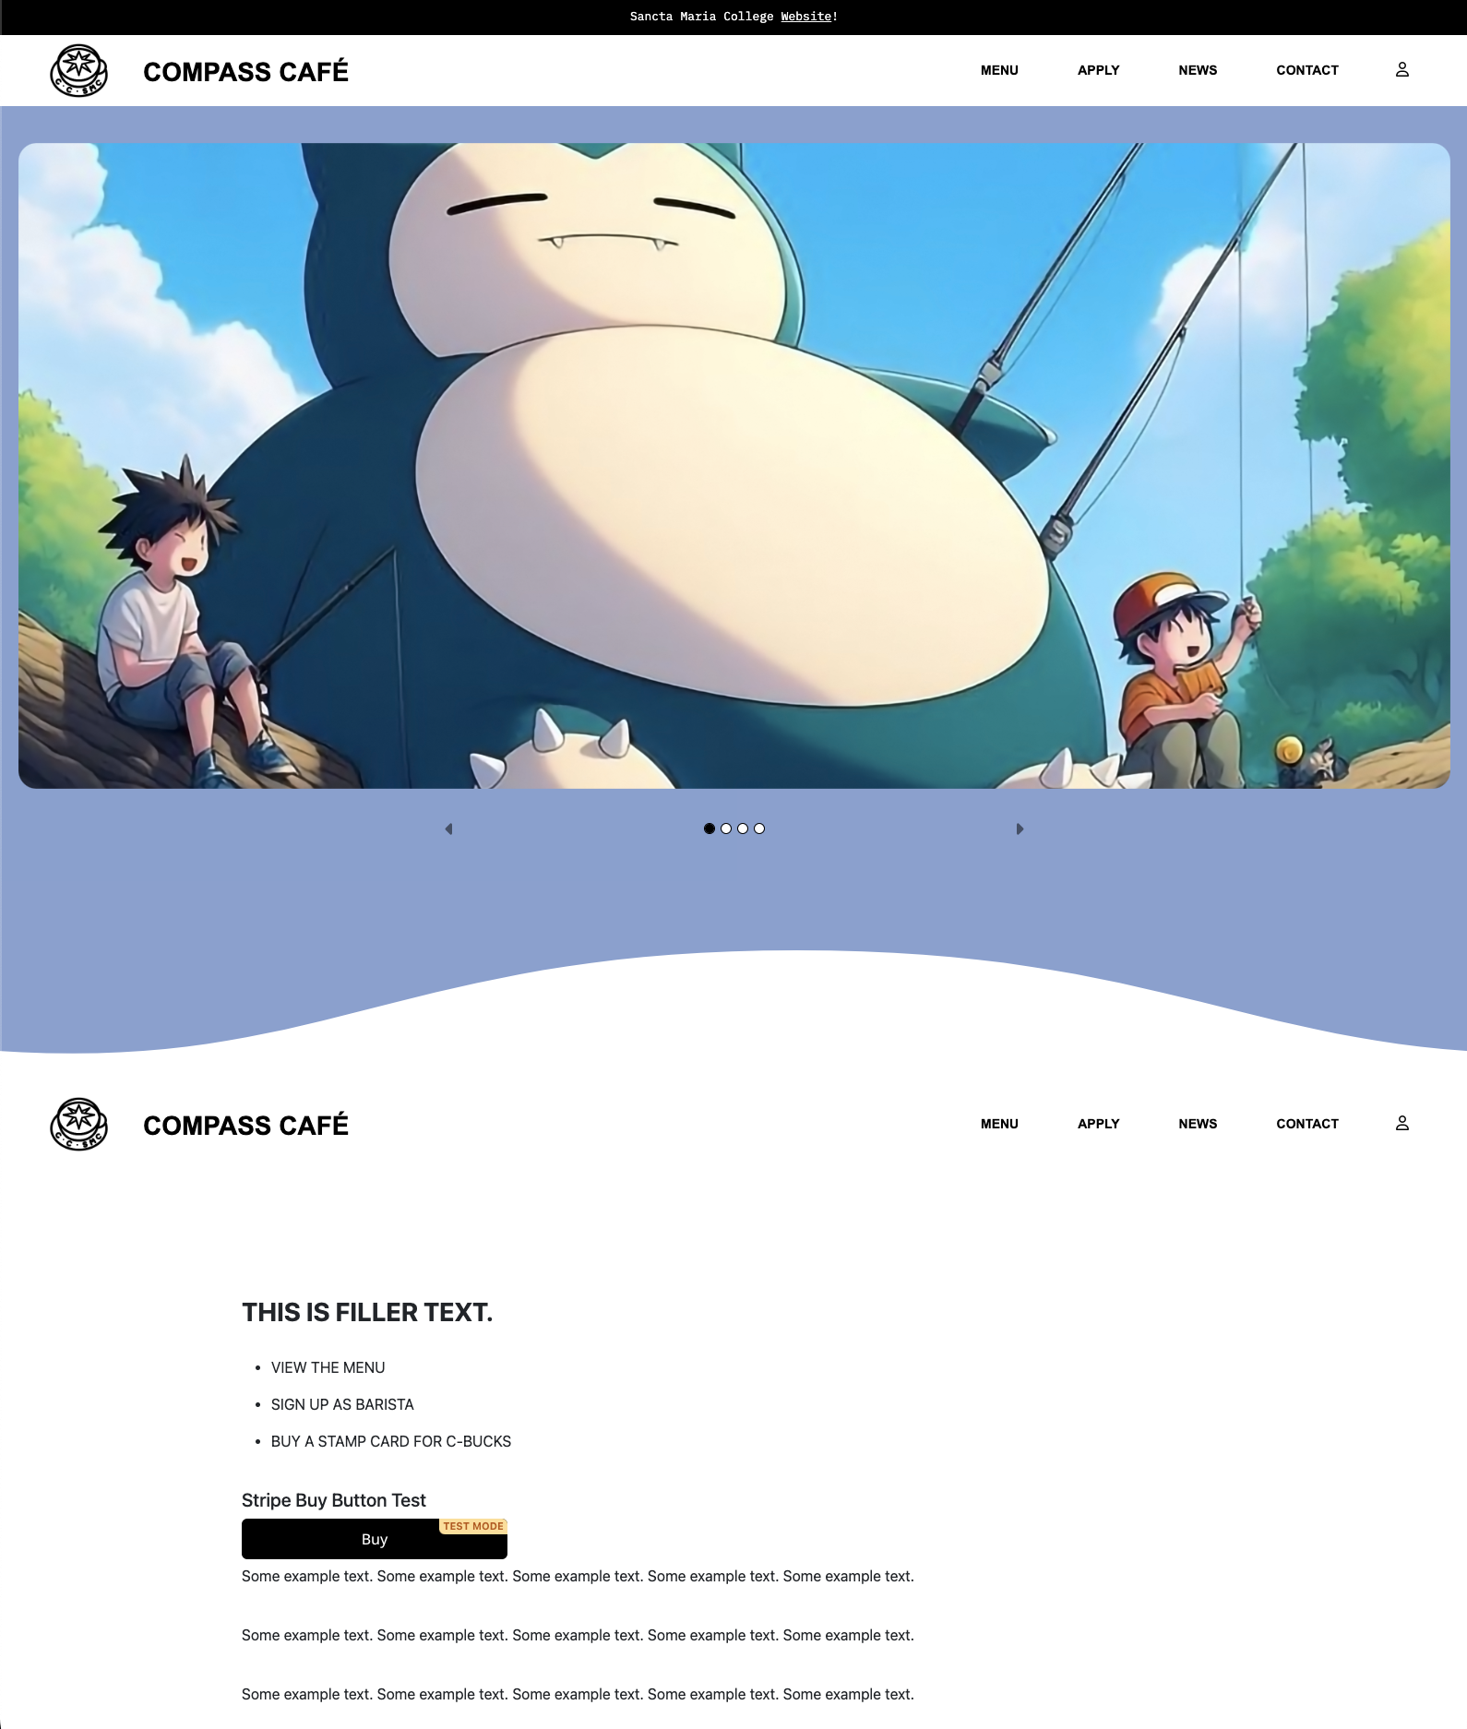
WEBSITE DESIGN : PAGES
CONCEPT
Page/Form design Drawings (duplicate as required). Design drawings for each of your pages

Slide 25
TEST PLAN
How are you going test your program
to ensure it functions correctly
That the python code is PEP8 compliant
for validation and error correction
Is well structured
Is flexible and robust
Comprehensively tested and debugged

Slide 26
TEST RESULTS
Summarise the results of your testing and how you addressed any issues or problems that arise during testing. Make sure you get others to test your site and get feedback.

Slide 27
USER REQUIREMENTS
Describe how the chosen tools and techniques to develop the website were appropriate for the purpose and end users.

Slide 28
ITERATIVE IMPROVEMENT
Show how you have used iterative improvement throughout the design, development and testing process to produce a high-quality outcome. (through providing screenshots/a screencast)

Slide 29
VERSION CONTROL
Show how you have used version control throughout the design, development, and testing process.

Slide 30
GITHUB COMMITS
Show how you have used GitHub throughout the design, development, and testing process.

Slide 31
ADDRESSING RELEVANT IMPLICATIONS
Discuss how have you addressed relevant implications?

Slide 32
PRIVACY
IMPLICATION 01
Discuss how have you addressed relevant implications?

Slide 33
USABILITY
IMPLICATION 02
Discuss how have you addressed relevant implications?

Slide 34
SUSTAINABILITY & FUTURE PROOFING
IMPLICATION 03
Discuss how have you addressed relevant implications?

